Slide 1
Doing Business in Egypt 2014
Understanding Regulations for
Small and Medium-Size Enterprises
Najy Benhassine
Manager, Business Regulation
Investment Climate – World Bank Group
Alessio Zanelli
Private Sector Development Specialist
Global Indicators Group – World Bank Group
Cairo, December 8, 2013

Slide 2
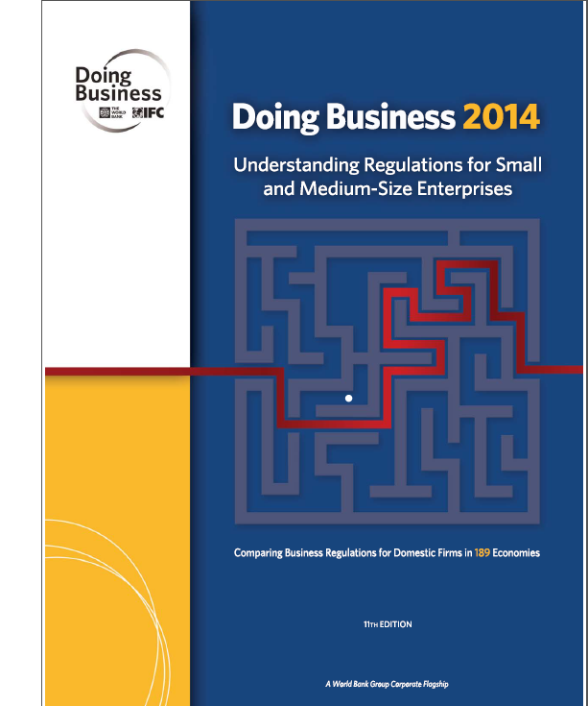
What does Doing Business measure?
Doing Business indicators:
Focus on regulations relevant to the life cycle of a small to medium-sized domestic business.
Are built on standardized case scenarios.
Are measured for the most populous city in each country.
Are focused on the formal sector.
DO NOT measure all aspects of the business environment such as macroeconomic stability, corruption, level of labor skills, proximity to markets, or of regulation specific to foreign investment or financial markets.

Slide 3
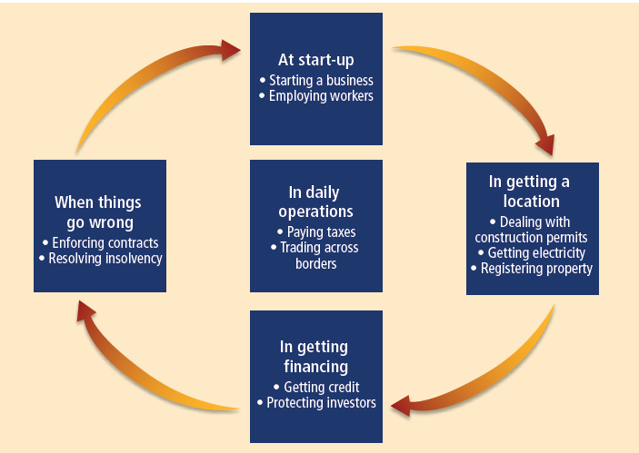
Regulations as measured by Doing Business affect firms throughout their life cycle
3

Slide 4
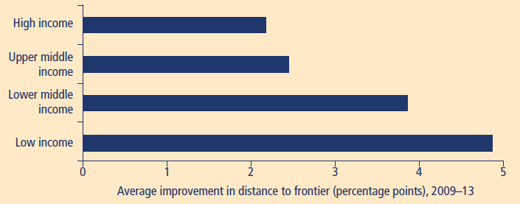
Low-income economies have narrowed the gap with the regulatory frontier the most since 2009
Note: The distance to frontier measure shows how far on average an economy is at a point in time from the best performance achieved by any economy on each Doing Business indicator since 2003 or the first year in which data for the indicator were collected. The measure is normalized to range between 0 and 100, with 100 representing the frontier. The data refer to the 183 economies included in Doing Business 2010 (2009) and to the income group classifications for 2013. Six economies were added in subsequent years.
Source: Doing Business database.

Slide 5
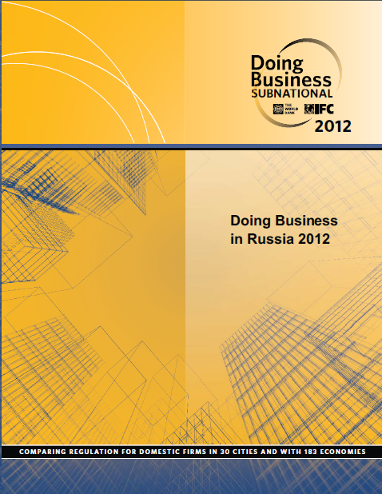
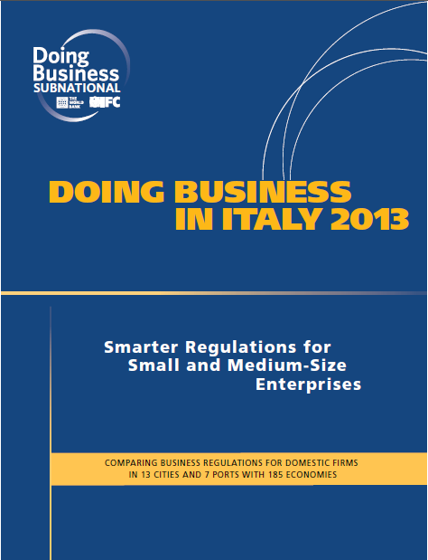
What do Subnational reports add?
Expand Doing Business indicators beyond the largest business city measured by the annual report
Include rules and regulations at all levels of government
Capture local differences in regulations or enforcement
Provide information on good practices within the same country that can be easily replicated
Provide a tool for locations to tell their story and to compete globally
Combine Doing Business media appeal with active participation of subnational governments in the reform process

Slide 6
Subnational Doing Business finds that the cost to deal with construction permits varies widely across cities within the same country or region
Dealing with Construction Permits
Half of the cities
Half of the cities
Cost (% of income per capita)
Source: Doing Business database
Note: Subnational Doing Business studies measured 23 cities in Colombia (2013), 13 in Italy (2013), 13 in Kenya (2012), 20 in Indonesia (2013), 30 in Russia (2012), 32 in Mexico (2012), 25 in Philippines (2011), 22 in in South East Europe (Albania, Bosnia and Herzegovina, Croatia, Kosovo, FYR Macedonia, Montenegro, and Serbia- 2011) and 37 in Nigeria (2010)

Slide 7
Comparisons across locations in the same country show potential of reforms
Dealing with construction permits, Russia. What if the best regional practices were adopted in Moscow?
Procedures
Global DB Data for Russia*
181st
Time
173th
Best practice in Russia
Improvement in Global DB
Rank
(1-183)
51
423 days
Cost **
113th
103th
183%
78th
46th
150 days
40%
*Data published in Doing Business 2012, as measured for Moscow by June 2012
** As % of income per capita

Slide 8
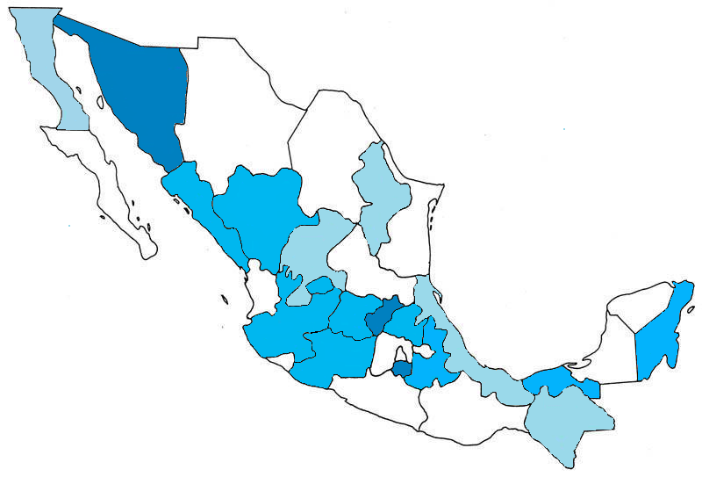
Spontaneous exchanges of good practices among states in Mexico between 2009 and 2012
Baja California
Sonora
Chihuahua
Coahuila
Aguascalientes
Baja California Sur
Sinaloa
Nuevo León
Querétaro
Durango
# of states contacted
Hidalgo
Zacatecas
State of Mexico
7 -9
Tamaulipas
4 – 6
San Luis Potosí
Mexico City
Nayarit
1 – 3
Guanajuato
Tlaxcala
Yucatán
0
Jalisco
Michoacán
Quintana Roo
Consulted by
Colima
Puebla
Tabasco
Campeche
7 states
5-6 states
Veracruz
4 states
Guerrero
Oaxaca
Chiapas
3 states
Morelos
2 states
Source: Doing Business in Mexico 2012

Slide 9
South East Europe improved business entry significantly from 2008 to 2011
Starting a business indicator, South East Europe (SEE), as measured in 2008 and 2011
26
SEE average 2008
22.3
SEE average 2011
15
EU average 2011
10
6
5.7
Skopje
Pljevlja (Montenegro)
Best in SEE 2011: Skopje
(FYR Macedonia)
3
1.5
3
Source: Doing Business in South East Europe 2011

Slide 10
Research on the effects of business regulations
Simpler entry regulations increase formalization and employment
E.g. Branstetter and others 2013, Bruhn 2013, 2011, Kaplan, Piedra and Seira 2011, Barseghyan 2008. Simplified business registration led informal firms to shift to the formal economy and increased employment.
Faster construction permits can increase construction spending and tax revenue
E.g. PricewaterhouseCoopers 2005
Efficient property registration can boost property values and investment
E.g. Burns, Anthony 2002, Galiani and Ernesto Schargrodsky 2010. Land titling projects led to an increase in property values and quality, reduced household size and enhanced education.
Improvements in trade facilitation stimulate exports
E.g. Freund and Rocha 2011, Djankov, Seker 2011, Freund and Pham 2010. Reduction in transport time leads to significant increases in the export volumes of economies.

Slide 11
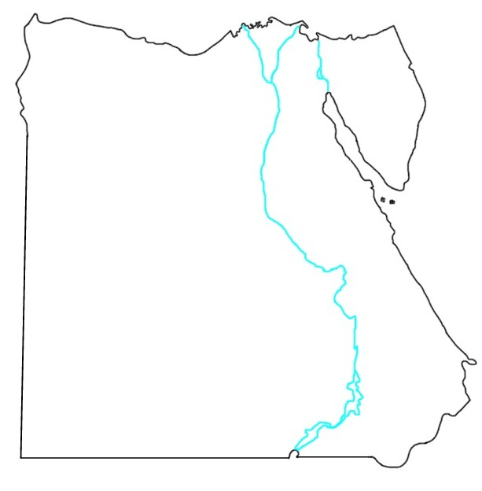
Doing Business in Egypt 2014
Alexandria
Damietta
Port Said
Four indicators benchmarked in 15 locations:
Starting a Business
Dealing with Construction Permits
Registering Property
Enforcing Contracts
Trading Across Borders measured in 5 strategic ports:
Alexandria
Damietta
Port Said East
Port Said West
Sokhna (Suez)
Mansoura
Tanta
Ismailia
Zagazig
Cairo
Giza
Suez
Fayoum
Assiut
Sohag
Kharga
Project carried out in collaboration with the Ministry of Investment and the Ministry of Local Development of the Arab Republic of Egypt
Aswan

Slide 12
Ease of obtaining information on requirements and fees varies across locations
Ease of access to information and fee schedules related to construction permits across 15 cities

Slide 13
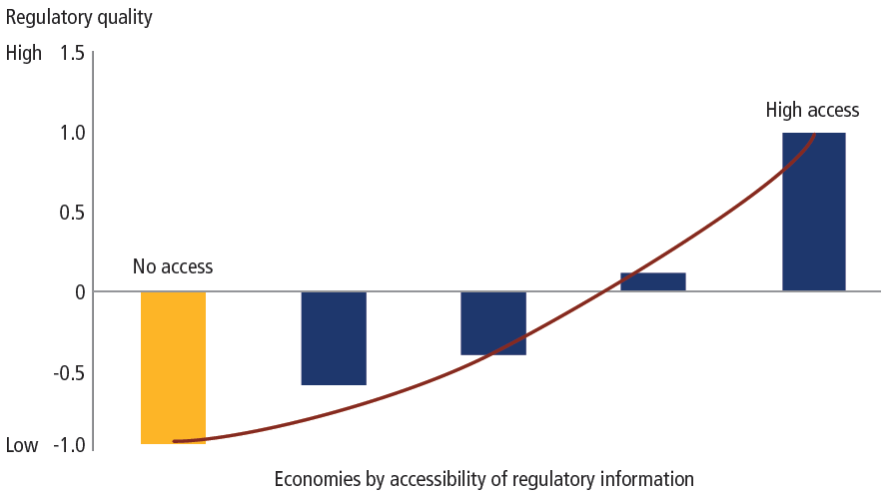
Access to information is associated with greater trust in regulatory quality

Slide 14
Key findings
The success of business start up one-stop shops proves that there is no need to come to Cairo to start a business
Despite a nationally unified construction law, there are large variations in requirements, time and cost across locations
Some court of first instance found successful ways to deal with high case loads
In property registration, better coordination between the real estate registry and surveying authority shortens processing delays
Exporters and importers spend most time on paperwork
No need to reinvent the wheel: successful examples of good regulatory practices can be found across Egypt

Slide 15
Success stories can be found across Egypt
City | Ease of starting a business | Ease of dealing with construction permits | Ease of registering property | Ease of enforcing contracts
Alexandria, Alexandria | 1 | 15 | 4 | 11
Assuit, Assuit | 4 | 7 | 10 | 14
Aswan, Aswan | 15 | 14 | 12 | 7
Cairo, Cairo | 1 | 12 | 13 | 15
Damietta, Damietta | 10 | 5 | 15 | 1
Fayoum, Fayoum | 6 | 13 | 3 | 3
Giza, Giza | 1 | 11 | 7 | 4
Ismailia, Ismailia | 4 | 3 | 5 | 2
Kharga, New Valley | 14 | 4 | 8 | 10
Mansoura, Dakahlia | 6 | 2 | 2 | 11
Port Said, Port Said | 12 | 10 | 1 | 7
Sohag, Sohag | 12 | 9 | 6 | 6
Suez, Suez | 10 | 1 | 8 | 9
Tanta, Gharbia | 8 | 6 | 14 | 5
Zagazig, Sharqia | 8 | 7 | 11 | 13

Slide 16
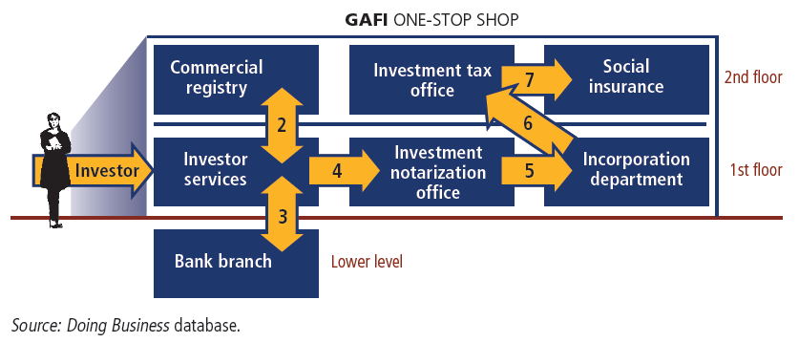
Starting a business: one-stop shops are making it easier across cities

Slide 17
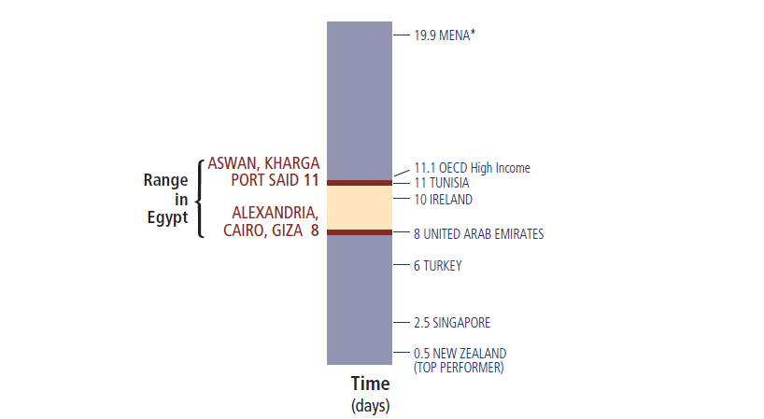
Starting a Business across Egypt: as fast as in OECD High Income Economies
*MENA is the Middle East and North Africa regional average

Slide 18
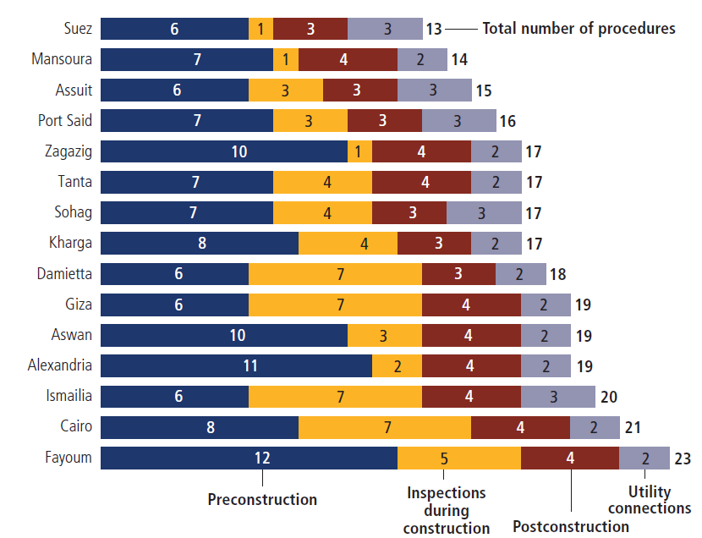
Dealing with construction permits: wide variation in pre-construction approvals and inspections

Slide 19
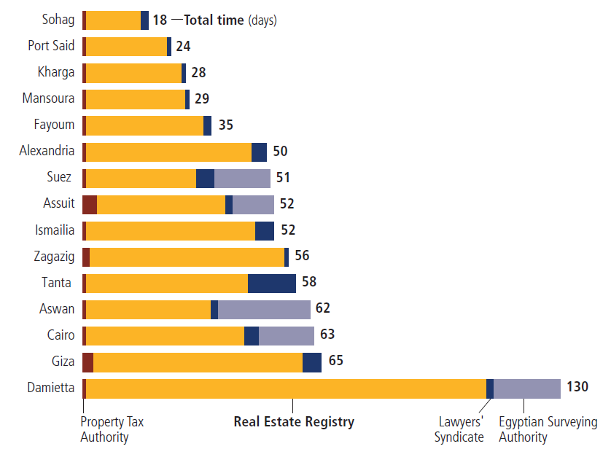
Registering property: time differences driven by the efficiency of local Real Estate Registries and coordination with Surveying Authority

Slide 20
No need to reinvent the wheel: successful examples of good practices found across Egypt
Doing Business indicator | Best practices within Egypt |  | Egyptian best practices compared internationally (global rank) | Egypt’s performance in DB2014 (represented by Cairo, global rank)
Dealing with construction permits | 13 procedures | Suez | 39 | 149
 | 109 days | Ismailia
 | 58.9% of income per capita | Suez
Registering property | 7 procedures | Alexandria, Fayoum, Giza, Ismailia, Kharga, Mansoura, Port Said, Sohag, Tanta, Zagazig | 56 | 105
 | 18 days | Sohag
 | 0.7% of property value | Alexandria, Assuit, Aswan, Cairo, Damietta, Fayoum, Giza, Ismailia, Mansoura, Port Said, Suez
Enforcing contracts | 42 procedures | All cities | 103 | 156
 | 706 days | Ismalia
 | 18.2% of claim value | Damietta and Fayoum
Ease of doing business |  |  | 104 | 128

Slide 21
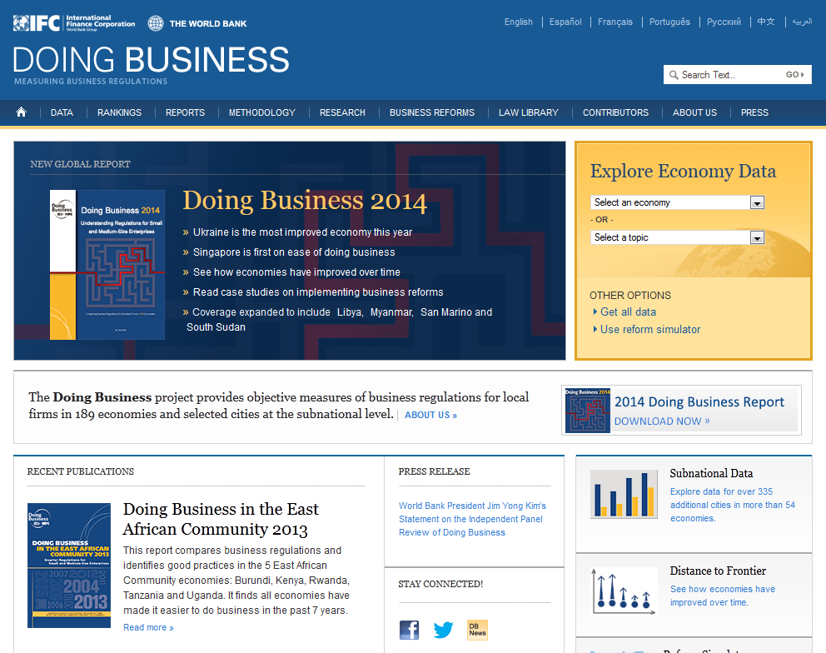
Thank you! For more information: www.doingbusiness.org

